Slide 1



E- Administration
eProject – Sem 4
Group :Van Ngo – Son Hoang – Ngoc Phan
Class : Batch 54B
Teacher : Mr. Hoang Nhac Trung

Slide 2

Contents
1
Introduction
2
Functions requirement
3
Non-functions requirement
4
System Architecture

Slide 3
Introduction
The project e-Administration of computer labs is an automated system for lab management.
It is to provide the solution for an organization which involve computing facilities such as Computers, Printers, LCDs, Digital Boards, ACs etc. on a 24×7 bases to carry out academic experiments for all the branches with all the equipment in good working conditions and also with all the necessary software’s installed and configured.
This software also helps the administrator and instructor(s) to maintain proper documentation of the computing systems.

Slide 4
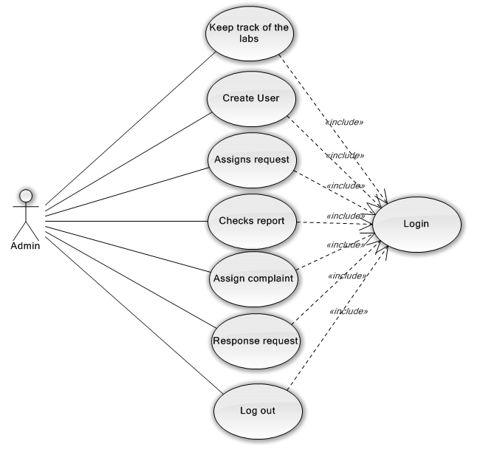
Functions and Non-functions
Function Requirement Specification
- User admin
Creates user, assigns access rights, authenticates users, checks report, and assigns task. These functions are used to keep track of various activities in labs.

Slide 5
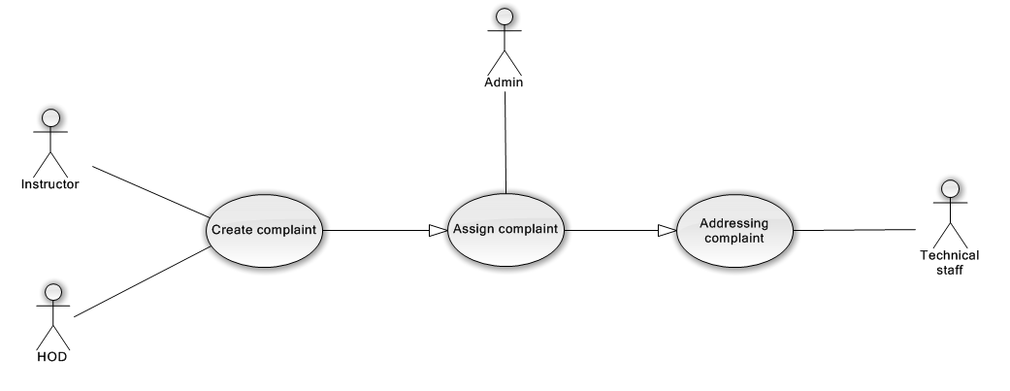
Functions and Non-functions
Function Requirement Specification
- Service complaint
It includes complaint registration, assigning task to instructor, addressing complaint. These functions may be used to register a complaint about improper conditions of devices (in lab) to admin in order to get response/service.

Slide 6
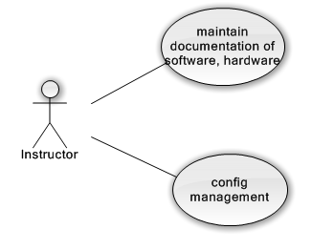
Functions and Non-functions
Function Requirement Specification
- Software or hardware maintenance
This module checks warranty of particular software, generates alert messages and helps in proper documentation of available software’s or hardware’s in labs

Slide 7
Functions and Non-functions
Function Requirement Specification
- Lab assignment
This module defines slots, generates charts, assigns instructor’s, and would specify alternate instructor to particular labs
Report generation
This module generates service report and reports for working condition of the equipment’s in the lab.

Slide 8
Functions and Non-functions
Non - Function Requirement Specification
- Safety Requirements
- Security Requirements
Software Quantity Attributes
+ Correctness
+ Maintainability
+ Usability

Slide 9
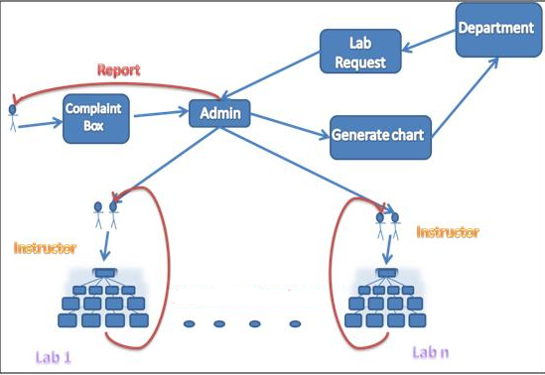
System Architecture

Slide 10
Thank You!
All team

